Slide 1
GUI PRESENTATION
Presented By : Varad Paralikar

Slide 2
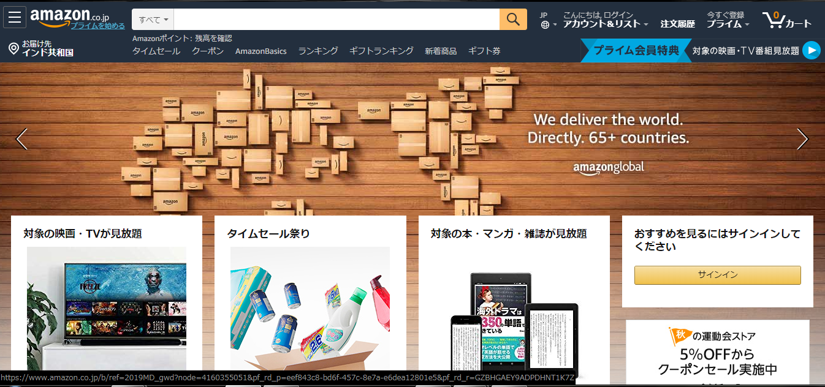
HOME PAGE
1
2
4
3
5
6
8
7

Slide 3
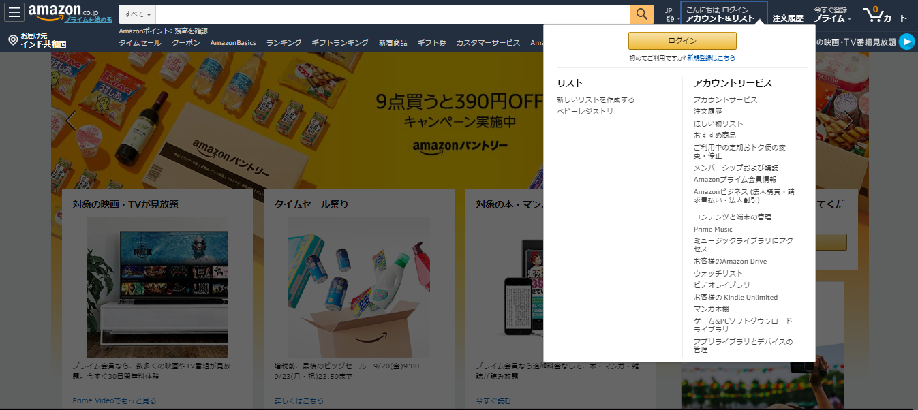
HOME PAGE
9

Slide 4
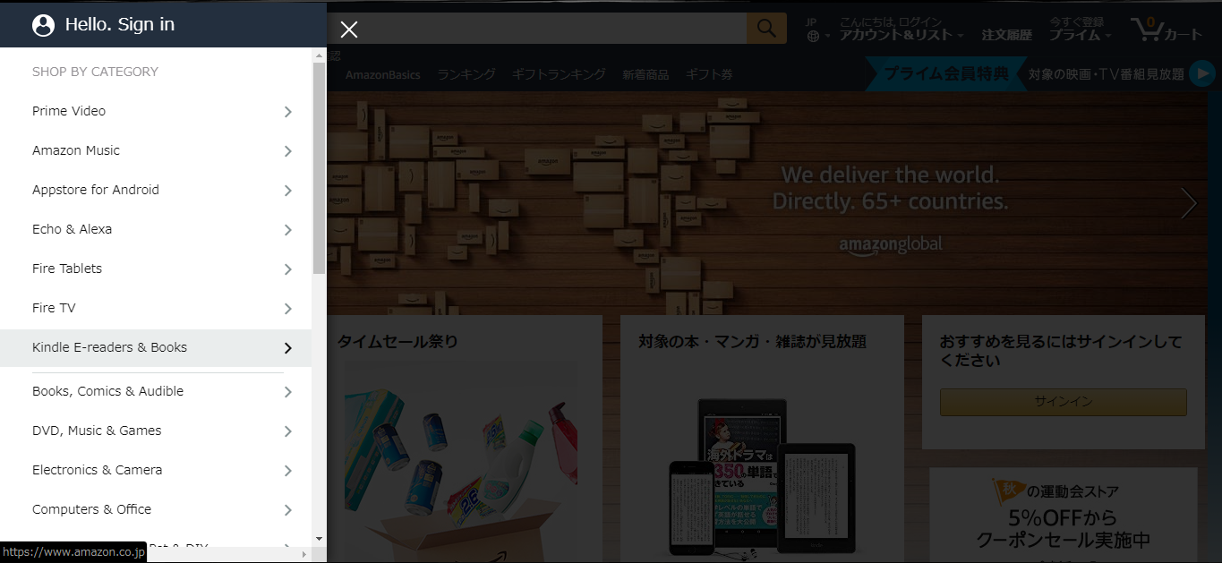
HOME PAGE
10

Slide 5
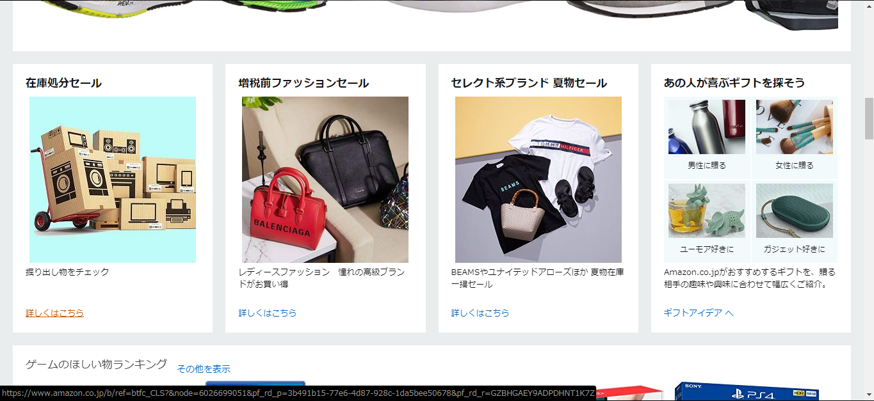
HOME PAGE
11

Slide 6
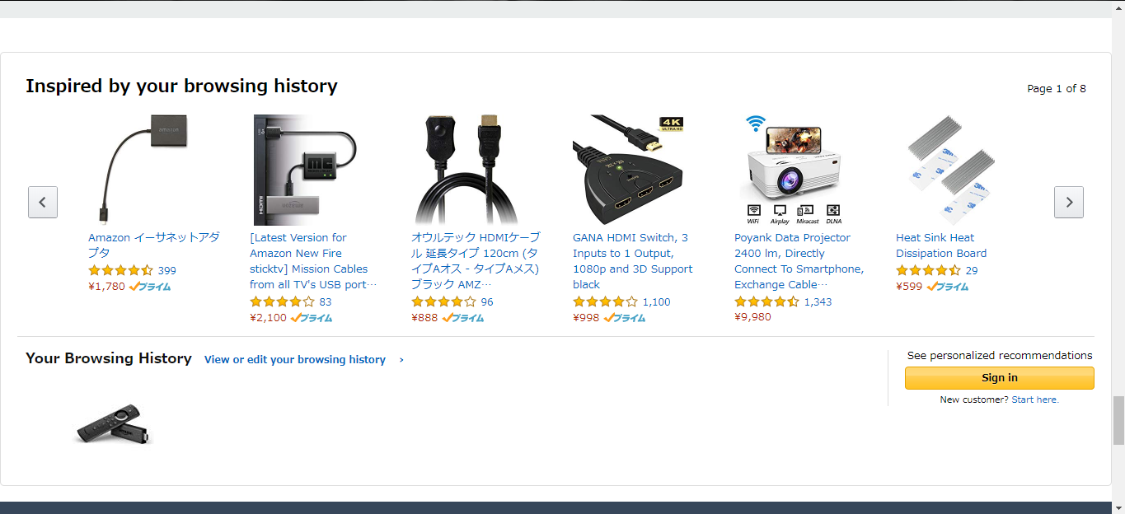
HOME PAGE
12
10

Slide 7
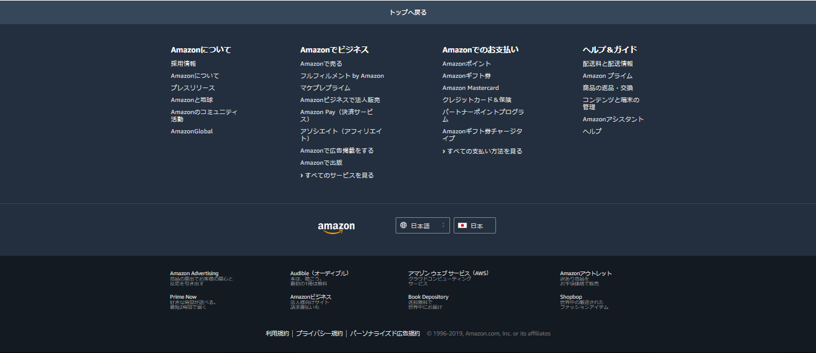
HOME PAGE
13

Slide 8
What Looks Good in Home Page
Dropdown is provided besides title with gold color and not much space is taken by the title at the top left corner of home page.
Search field is provided in the header.
New user account login is provided in header with white color text for clear display.
Language change with icon is provided besides search bar with current language of page is being shown.
Shopping cart is provided in top right corner showing current items count with attractive icon of a cart.
Current location is shown for shipping purpose.
User is being prompted to sign in for seeing recommendations.
Items are being displayed using card layout with similar items occupying the same row having white background with black color text.
Onclick of register, popup occurring in card layout with white background and black color text for displaying information with background getting dim.

Slide 9
What Looks Good in Home Page
Onclick of dropdown button,menu with white background and black color text with options is being displayed with background getting dim.
Similar items are being displayed in card layout in the same row with view details button as link at bottom of item card. Cards have white background and black color text.
By studying users past browsing history,top items are being recommended to the user.
Footer is in dark grey background color with information having white color for clear display.

Slide 10
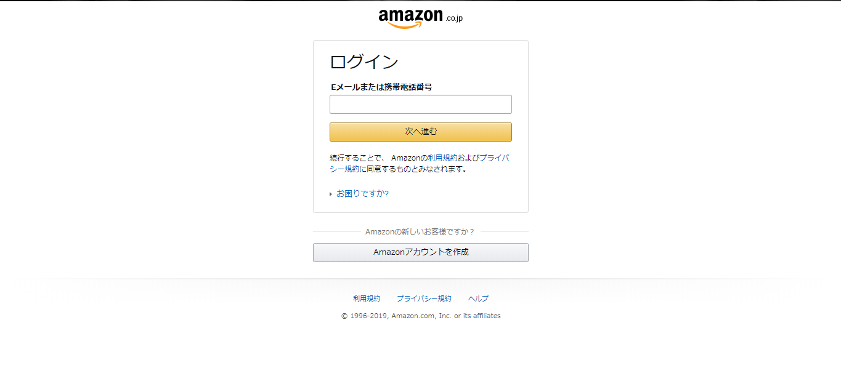
Login Page
1
3
2
4

Slide 11
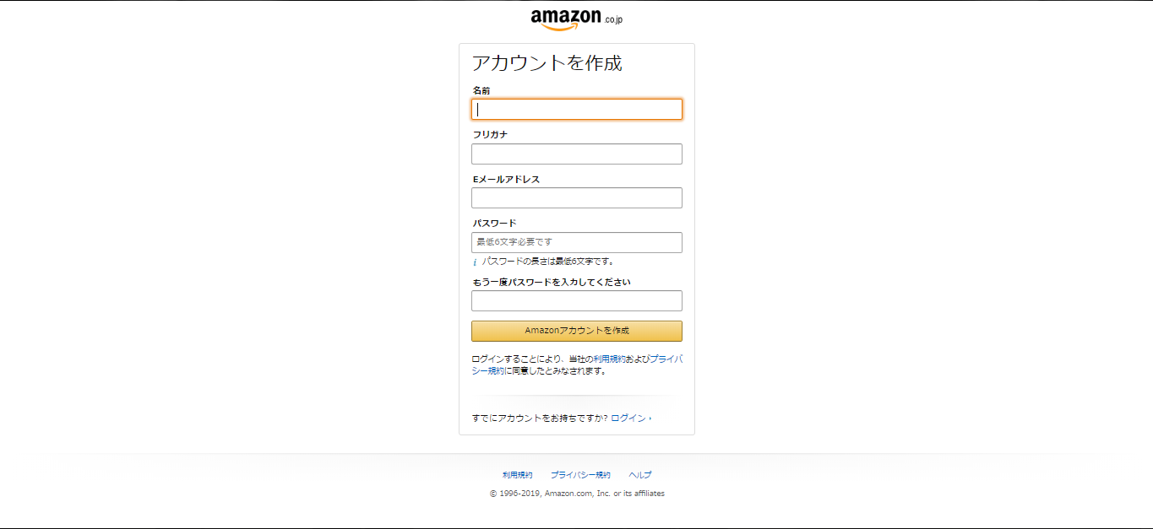
New Account Register
5
6
7
8

Slide 12
What Looks Good in Login and Register pages
Header has only Site Logo with center alignment.
Sign in button with gold color.
Email Or Phone number label with black color for clear display is provided.
Create account is given with silver color background for new users.
Focus is given on first field of form on page load with orange color for focus display.
Instructions with information icon is given below password field to instruct user for password policy.
Regiser Button in Orange color background
Footer with white shade at the bottom with black color text and blue color links for clear display.

Slide 13
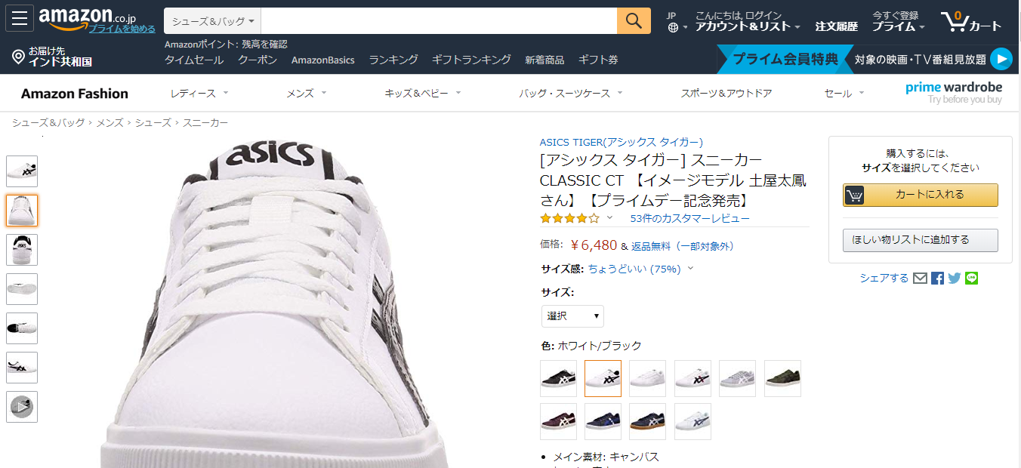
Product Detail
6
2
1
3
5
4
7

Slide 14
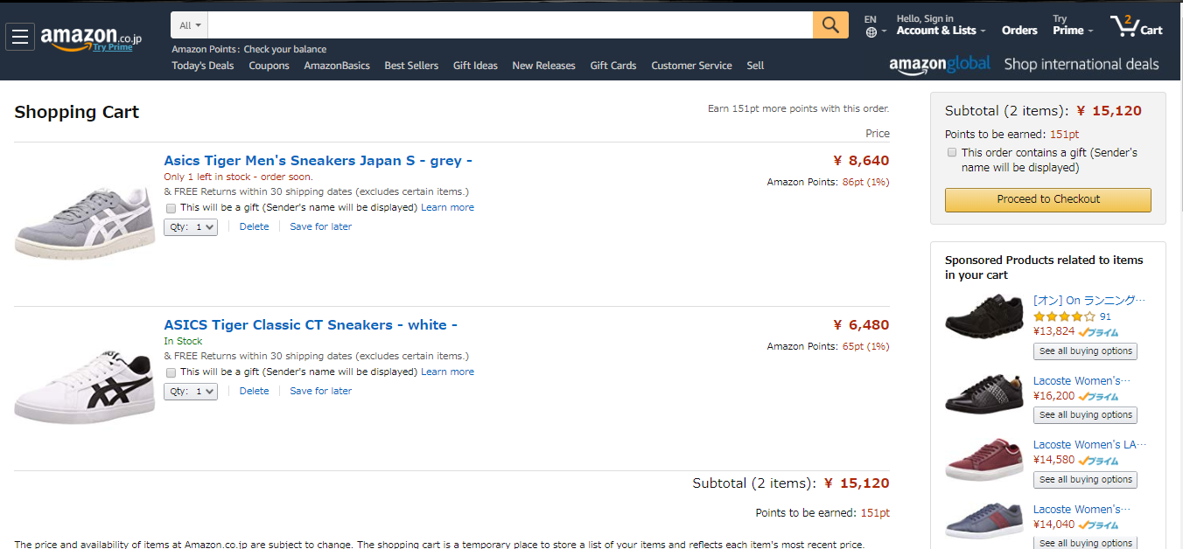
Product Detail
9
12
10
11

Slide 15
What Looks Good in Product Detail Pages
Add to shopping cart button is being shown with gold color.
Product name in Blue color and description in Black color
Product Price in Red Color
Tax amount is having background color as Red
Button in Orange Color
Header and Footer is same as Main Page (First Page)
Similar Product list is also displayed
Product review also displayed having background color as Black

Slide 16
sign in page
2
3
4
5
6
7
9
8

Slide 17
The logo of website shown in center of the page and panel
The block is in center of the page and in background is playing video.
Email address text field simple with place holder Email address
Password text field also simple with place holder Password
One checkbox is there to keep me login so do not login again and again
Small link is given forgot password and it is 50% blur
Login button has large in size and black in background color
One link is given if your account is not present then create the new user
Also face book login button is there to login from face book id in that button small face book logo is there which is so beautiful and easily understand it is face book login button

Slide 18
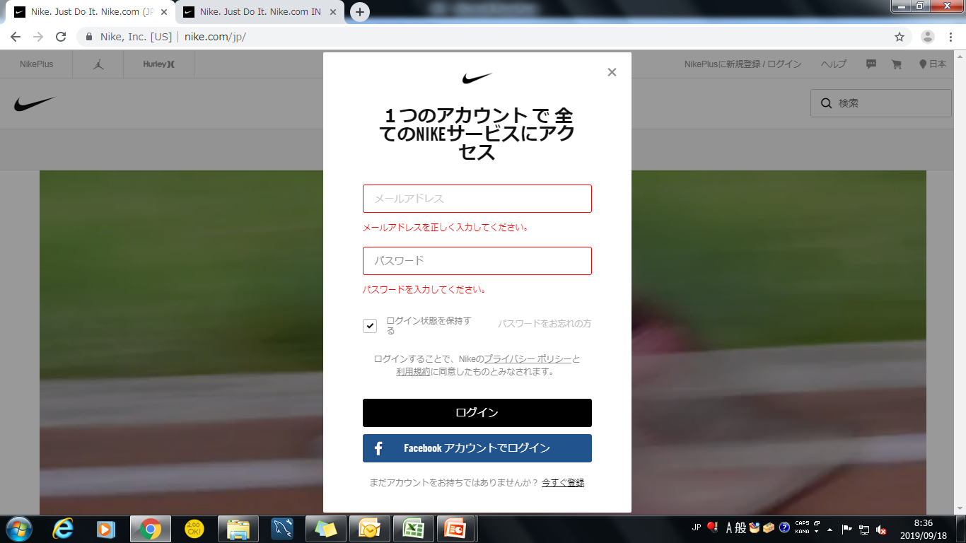
LOGIN PAGE ERROR MASSAGES
1
2

Slide 19
When click on login button it will show field level error please enter valid email address the font size is 12 and color of error massages is red
Please enter password also same red color massage with font size 12

Slide 20
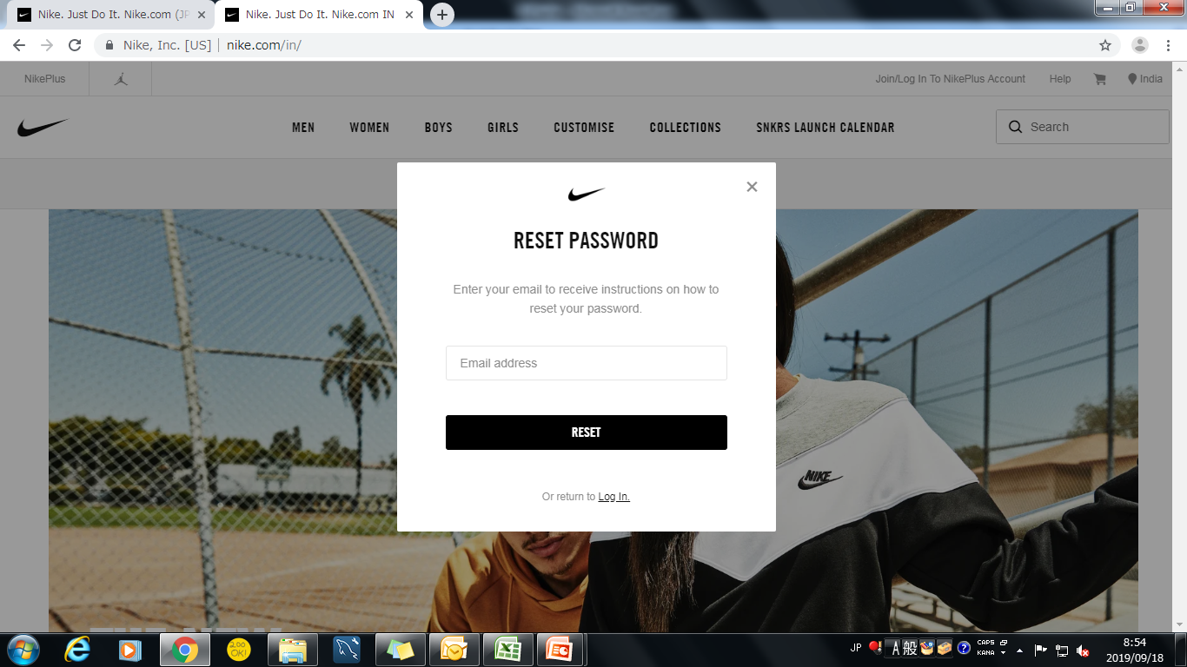
forgot password
1
2
3
4

Slide 21
New popup window with bold type heading reset password
Email address field is there to enter email id
With black background reset button is there to reset password
Small size of link is there to go back to the login page

